Slide 1
Unit 7 Series-Parallel Circuits
Part B: Analyzing Series-Parallel Circuits

Slide 2
What will you learn?
Simplify series-parallel circuits.
Apply concepts, formulas, circuit laws and rules to analyze series-parallel circuits.

Slide 3

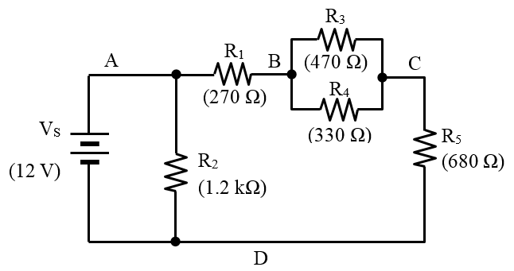

Illustration 1: Find the total resistance R_{T} across nodes A–D.
Step 1: Identify the parallel connection across nodes B–C.
Step 2: Determine the equivalent resistance R₃₄.
$$R_{34}=\frac{R_{3}R_{4}}{R_{3}+R_{4}}$$
$$=\frac{470×330}{470+330}$$
= 193.9 Ω

Slide 4
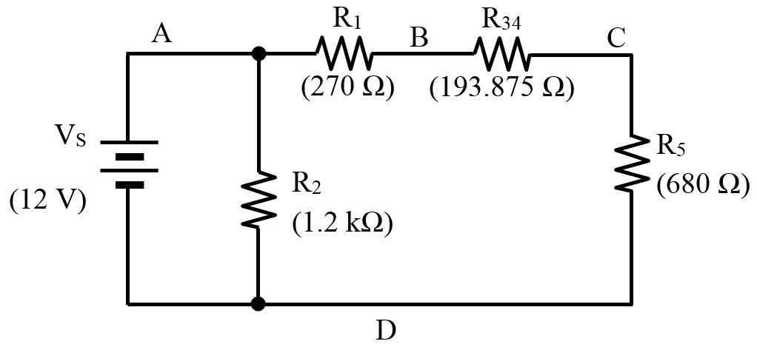
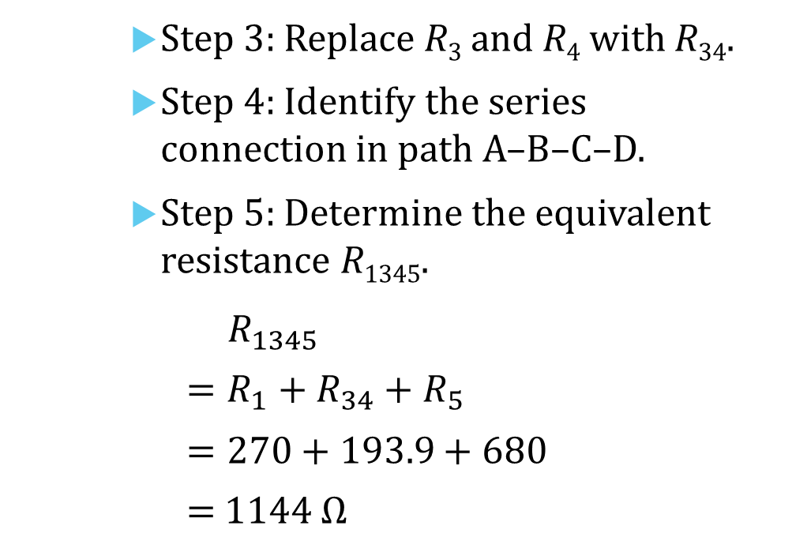
Illustration 1: Find the total resistance R_{T} across nodes A–D.
Step 3: Replace R₃ and R₄ with R₃₄.
Step 4: Identify the series connection in path A–B–C–D.
Step 5: Determine the equivalent resistance R₁₃₄₅.
$$R_{1345}$$
$$=R_{1}+R_{34}+R_{5}$$
$$=270+193.9+680$$
= 1144 Ω
(193.9 Ω)

Slide 5
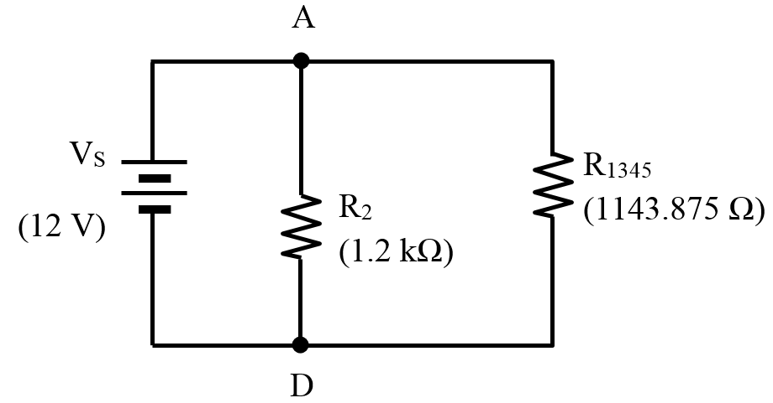

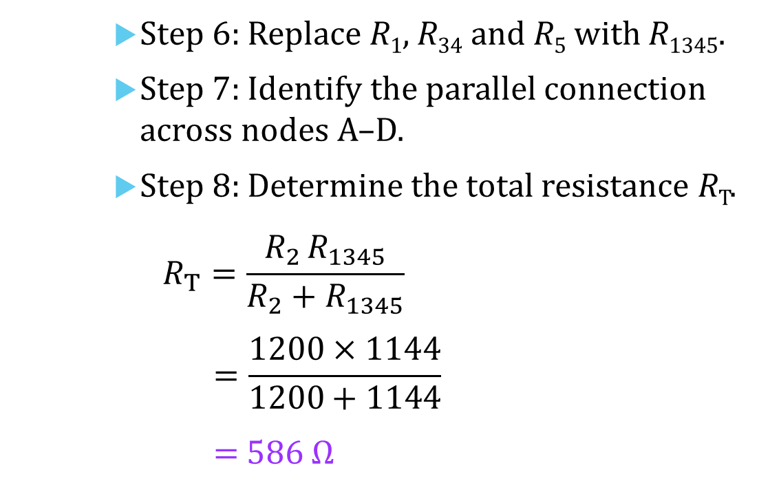
Illustration 1: Find the total resistance R_{T} across nodes A–D.
Step 6: Replace R₁, R₃₄ and R₅ with R₁₃₄₅.
Step 7: Identify the parallel connection across nodes A–D.
Step 8: Determine the total resistance R_{T}.
$$R_{T}=\frac{R_{2} R_{1345}}{R_{2}+R_{1345}}$$
$$=\frac{1200×1144}{1200+1144}$$
= 586 Ω
(1144 Ω)

Slide 6
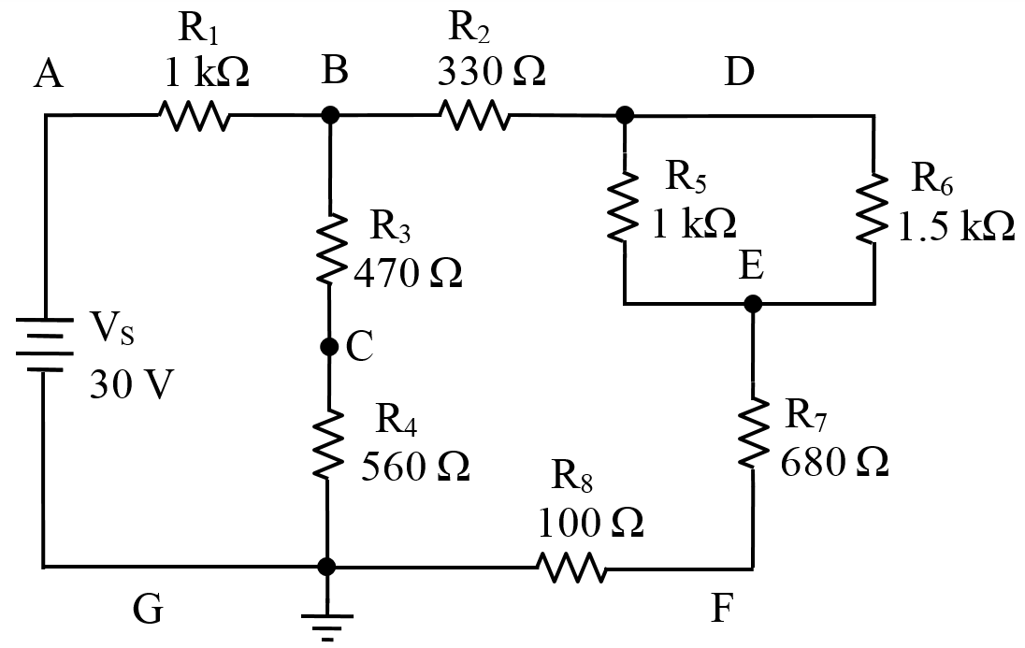
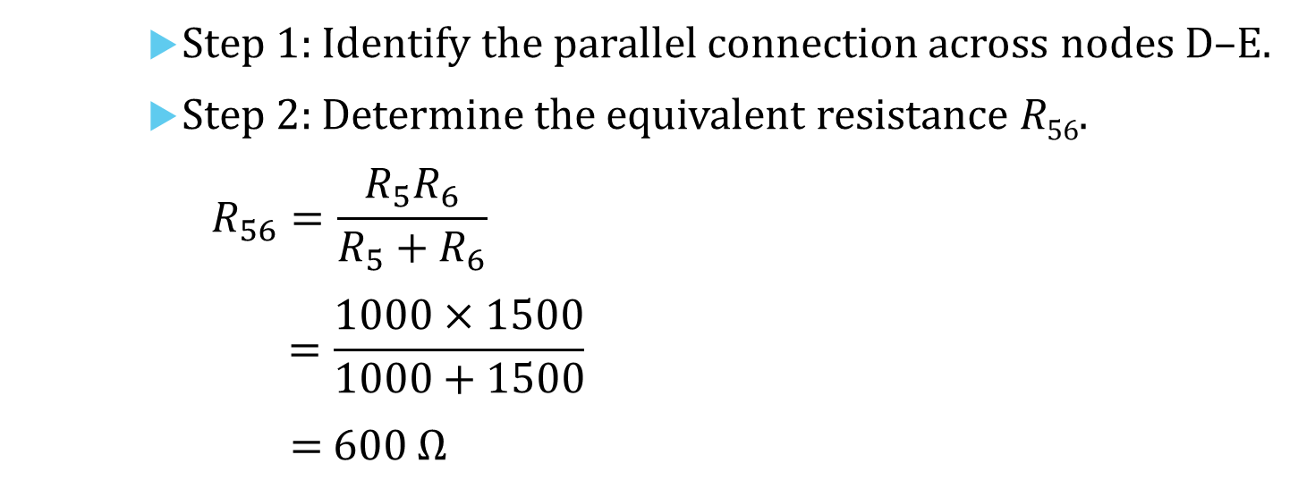
Illustration 2: Find the voltage across C and E, V_{CE}.
Step 1: Identify the parallel connection across nodes D–E.
Step 2: Determine the equivalent resistance R₅₆.
$$R_{56}=\frac{R_{5}R_{6}}{R_{5}+R_{6}}$$
$$=\frac{1000×1500}{1000+1500}$$
= 600 Ω

Slide 7
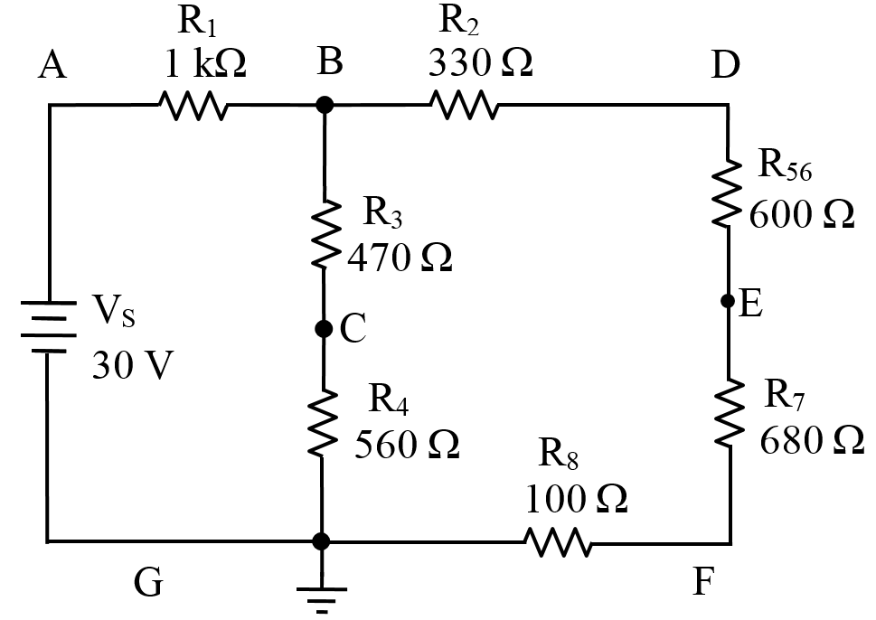
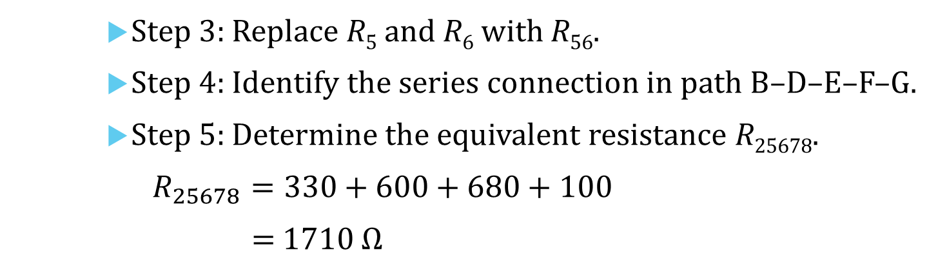
Illustration 2: Find the voltage across C and E, V_{CE}.
Step 3: Replace R₅ and R₆ with R₅₆.
Step 4: Identify the series connection in path B–D–E–F–G.
Step 5: Determine the equivalent resistance R₂₅₆₇₈.
$$R_{25678}=330+600+680+100$$
= 1710 Ω

Slide 8

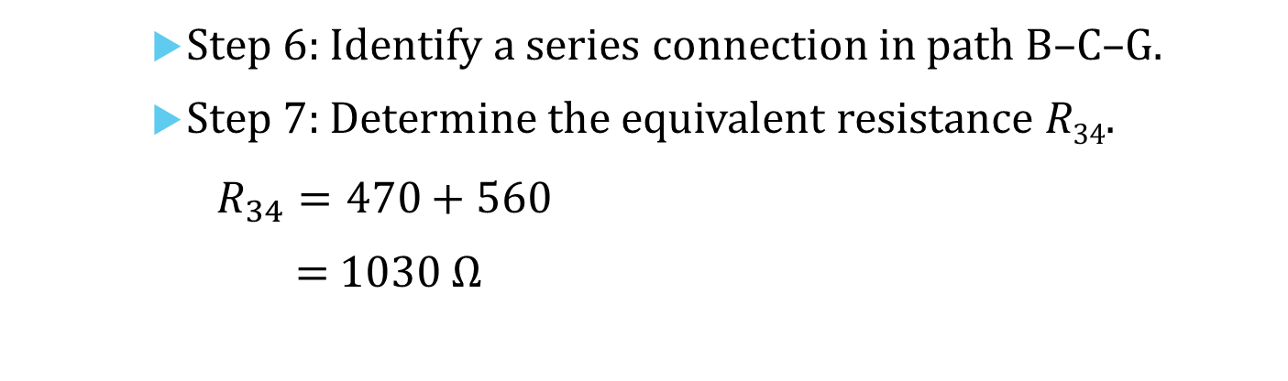
Illustration 2: Find the voltage across C and E, V_{CE}.
Step 6: Identify a series connection in path B–C–G.
Step 7: Determine the equivalent resistance R₃₄.
$$R_{34}=470+560$$
= 1030 Ω
$$R_{25678}=1710 Ω$$

Slide 9
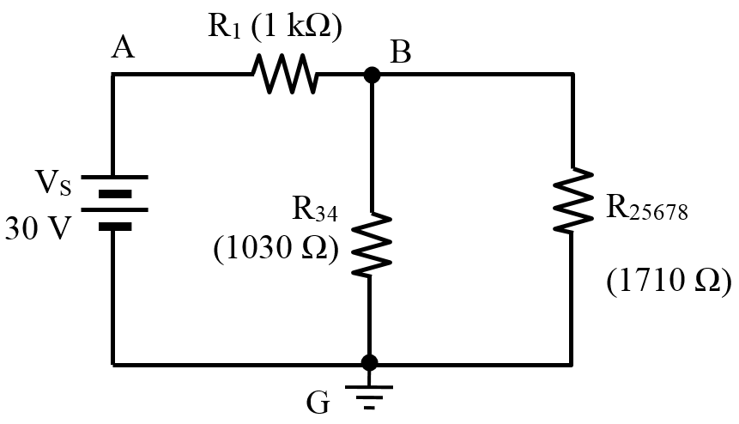
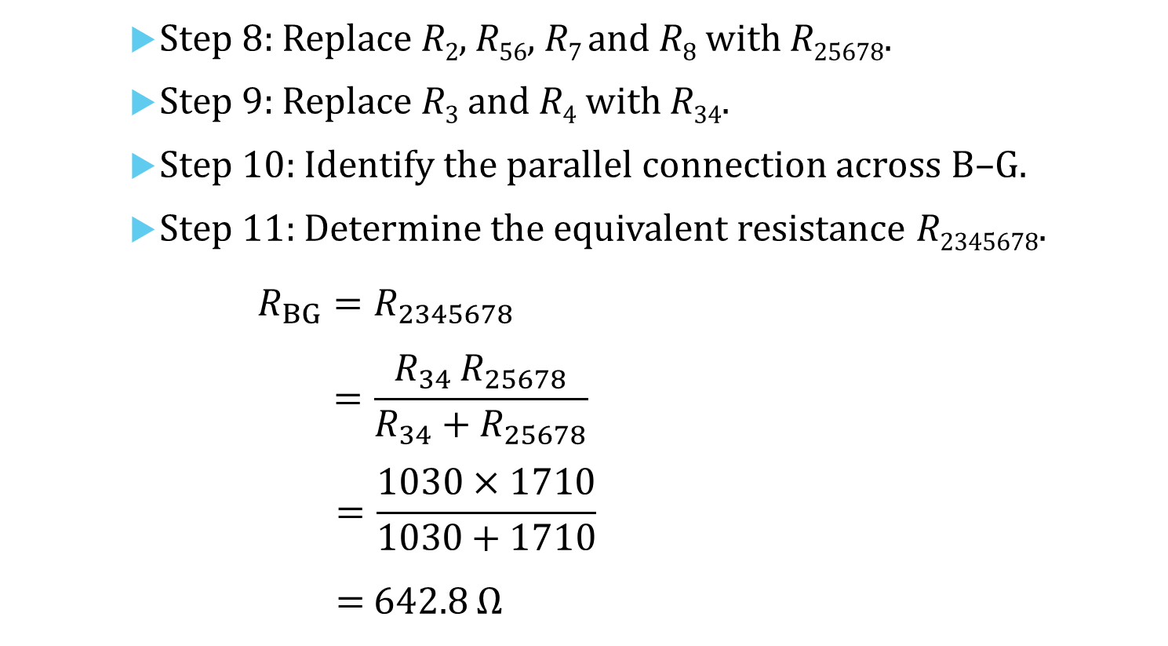
Illustration 2: Find the voltage across C and E, V_{CE}.
Step 8: Replace R₂, R₅₆, R₇ and R₈ with R₂₅₆₇₈.
Step 9: Replace R₃ and R₄ with R₃₄.
Step 10: Identify the parallel connection across B–G.
Step 11: Determine the equivalent resistance R₂₃₄₅₆₇₈.
$$R_{BG}=R_{2345678}$$
$$=\frac{R_{34}{ R}_{25678}}{R_{34}+R_{25678}}$$
$$=\frac{1030×1710}{1030+1710}$$
= 642.8 Ω

Slide 10
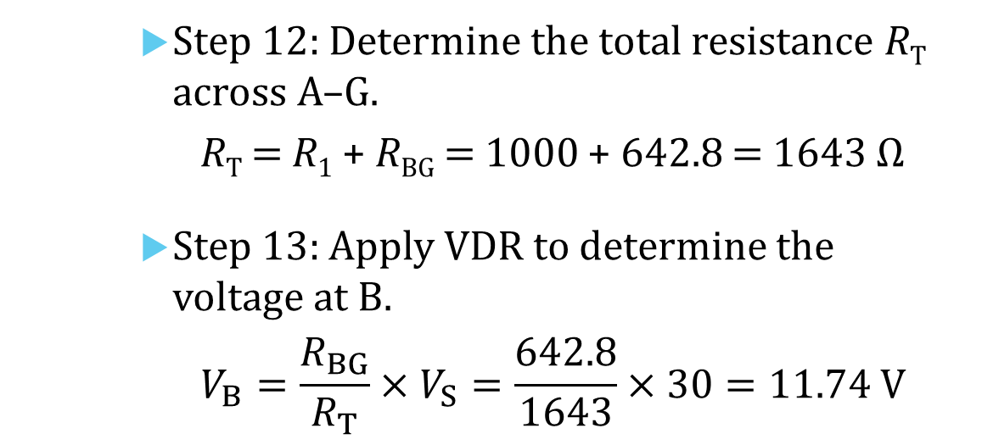
Illustration 2: Find the voltage across C and E, V_{CE}.
Step 12: Determine the total resistance R_{T} across A–G.
R_{T} = R₁ + R_{BG} = 1000 + 642.8 = 1643 Ω
Step 13: Apply VDR to determine the voltage at B.
$$V_{B}=\frac{R_{BG}}{R_{T}}×V_{S}=\frac{642.8}{1643}×30=11.74 V$$
V_{B}

Slide 11
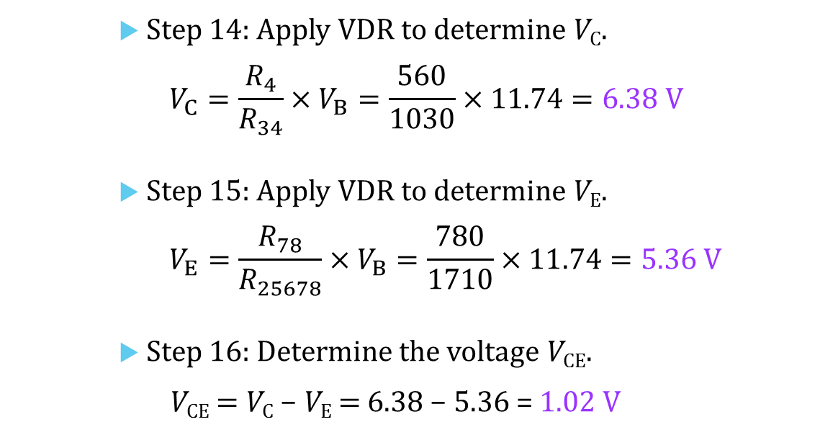
Illustration 2: Find the voltage across C and E, V_{CE}.
Step 14: Apply VDR to determine V_{C}.
$$V_{C}=\frac{R_{4}}{R_{34}}×V_{B}=\frac{560}{1030}×11.74=6.38 V$$
Step 15: Apply VDR to determine V_{E}.
$$V_{E}=\frac{R_{78}}{R_{25678}}×V_{B}=\frac{780}{1710}×11.74=5.36 V$$
Step 16: Determine the voltage V_{CE}.
V_{CE} = V_{C} − V_{E} = 6.38 − 5.36 = 1.02 V
V_{CE}
V_{C}
V_{E}

Slide 12
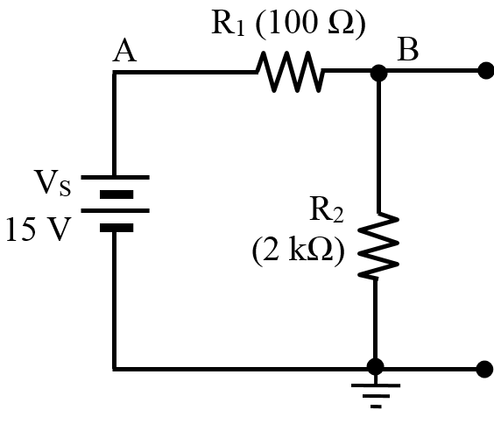
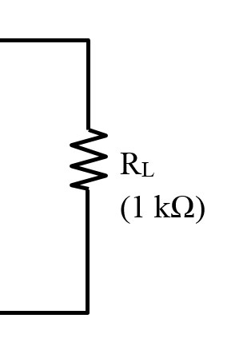
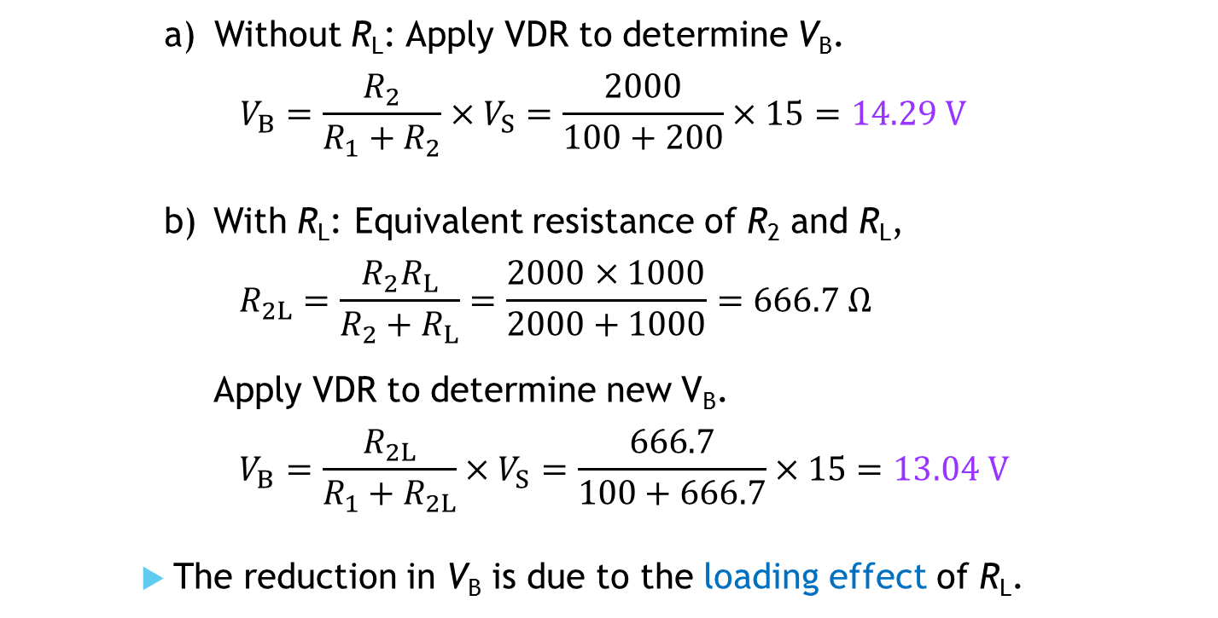
Illustration 3: Find the voltage at node B when (a) without R_{L} connected, and (b) with R_{L} connected.
Without R_{L}: Apply VDR to determine V_{B}.
$$V_{B}=\frac{R_{2}}{R_{1}+R_{2}}×V_{S}=\frac{2000}{100+200}×15=14.29 V$$
With R_{L}: Equivalent resistance of R₂ and R_{L},
$$R_{2L}=\frac{R_{2}R_{L}}{R_{2}+R_{L}}=\frac{2000×1000}{2000+1000}=666.7 Ω$$
Apply VDR to determine new V_{B}.
$$V_{B}=\frac{R_{2L}}{R_{1}+R_{2L}}×V_{S}=\frac{666.7}{100+666.7}×15=13.04 V$$
The reduction in V_{B} is due to the loading effect of R_{L}.

Slide 13
You have learned to
simplify complex series-parallel circuits,
replace series and parallel connections by their equivalent resistances,
apply circuit concepts, formulas, KVL, KCL, VDR, and CDR to analyze series-parallel circuits.

Slide 14
Coming Up Next
Power Dissipation in Series-Parallel Circuits

